Slide 1

E-COMMERCE CUSTOMER CHURN ANALYSIS & PREDICTION

Slide 2
INTRODUCTION
Customer Churn means when either of the following occurs:
a customer stops buying from a company
a customer leaves services of a company
a customer/client takes his/her business elsewhere
loss of existing clients/customers
E-Commerce Customer Churn is the term used to describe the number of customers who stop buying from an online store.
The churn rate is the percentage of customers who stop doing business with a company over a predetermined period.
HIGHER THE CUSTOMER CHURN RATE, LOWER THE CUSTOMER RETENTION RATE

Slide 3
MOTIVATION & OBJECTIVE
Customer churn affects the size of a company’s customer base and has a big impact on a company’s customer lifetime value. It is a significant challenge for e-commerce businesses, as it leads to revenue loss and increased marketing costs. Most online marketplaces have insufficient awareness of the e-commerce customer churn rate that can be analyzed before conducting customer retention activities or management.
The OBJECTIVE of this project is to predict customer churn, loss opportunity and provide recommendations to the business team, so that an e-commerce enterprise can formulate effective customer retention measures and implement successful marketing strategies. It is crucial for an online marketplace to handle customer churn as it is more high-value to manage existing customers than to have new customers on the platform.
The MOTIVATION behind this project is that e-commerce gives a global platform to every seller, increases self-employment and requires less investment to start a business. It also saves customer’s time and gives them convenient shopping experience.

Slide 4

EXPLORATORY DATA ANALYSIS (EDA) & PRE-PROCESSING THROUGH PYTHON

Slide 5

STEPS USED IN EDA & PRE-PROCESSING
Pre-EDA
Imported necessary libraries
Imported dataset
Comprehended the description of the dataset
Created a copy of the original dataset on which cleaning has been done
Columns
Checking bifurcation of columns into object datatype & non-object datatype
Renaming some columns
Values
Checking distinct values of each column
Fixing values of those columns having same values with different names
EDA
Univariate Analysis of categorical columns through FREQUENCY DISTRIBUTION
Bivariate Analysis
Categorical – Categorical columns through CROSSTAB
Categorical – Numerical columns through GROUPBY – AGGREGATION

Slide 6
Pre-Processing
Missing Value Treatment
Checked proportion of missing values present in each column
Filled missing values of columns having continuous nature by its MEAN
Filled missing values of columns having discrete nature by its MEDIAN
EXPORTED A COPY OF DATA (after missing value treatment) IN CSV FORMAT FOR FURTHER ANALYSIS IN SQL AND DASHBOARD IN POWER BI
Multi-Collinearity Treatment
Multivariate Analysis of non-object datatype columns through CORRELATION
Outlier Treatment
Finding outliers in the data through PERCENTILE METHOD
Bifurcating the data into two parts – Part-1, which has only object datatype columns and Part-2, which has only non-object datatype columns
CAPPING lower side outliers at 0.3% & upper side outliers at 99.7% in Part-2
Rejoining Part-1 & Part-2 (Revised) into new data {and dropping unnecessary columns in model development, if exists}
Checking & Treating Data Imbalance using SMOTE (over-sampling of minority records on the basis of target variable) in the new data
Dummy Creation of all categorical columns having non-binary format in the new data, after which the data has been used for model development & evaluation

Slide 7

SNAPSHOTS FOR EXPLORATORY DATA ANALYSIS (EDA)

Slide 8
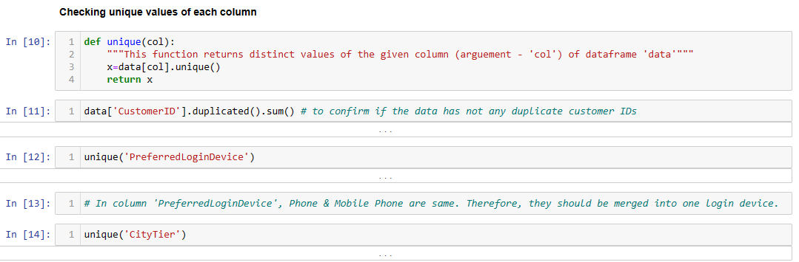
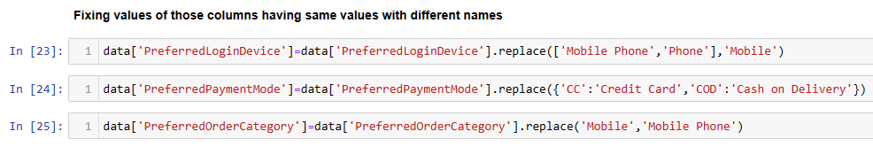

Slide 9
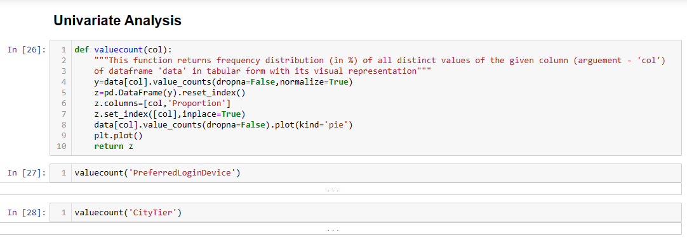
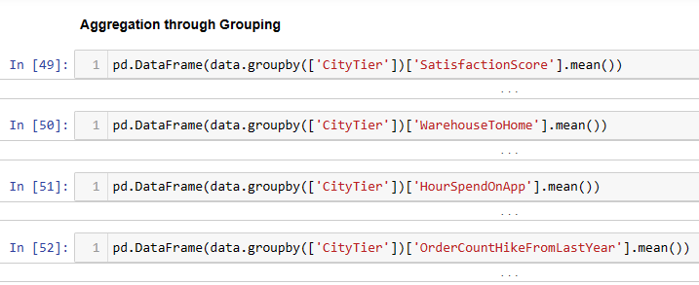
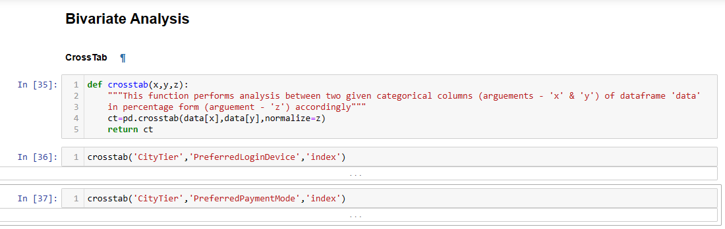

Slide 10

SNAPSHOTS FOR STRUCTURED QUERY LANGUAGE (SQL) QUERIES
In this project, Structured Query Language (SQL) has also been used for further analysis of e-commerce customer churn data. Data Definition Language (DDL) queries have been used for creating & altering database, table & view and Data Query Language (DQL) queries have been used for extracting data from the created tables in order to expand the analysis.

Slide 11
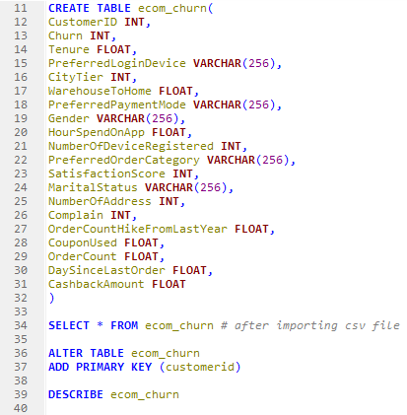
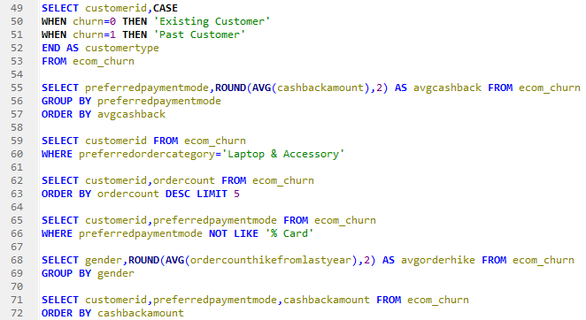
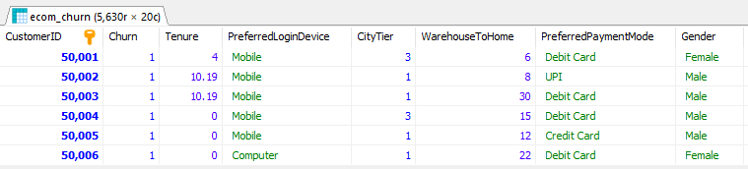

Slide 12

DATA INSIGHTS
The overall e-commerce customer churn rate is around 16.84%.
Around 71% of customers use MOBILE as their preferred login device.
Around 71.5% of customers have NO COMPLAINTS.
The customers having COMPLAINTS have churn rate of around 31.7%.
CITY TIERS 1 & 2 never preferred E-WALLET as payment mode.
CITY TIER 2 has the LOWEST TOTAL in NUMBER OF COUPONS USED as well as in ORDER COUNT.
The most preferred order category for MALE & FEMALE are MOBILE PHONE and LAPTOP & ACCESSORY respectively.
The customers having preferred order category GROCERY has the LOWEST CHURN RATE as compared to other preferred order categories.
The customers giving satisfaction score 5 out of 5 has the HIGHEST CHURN RATE as compared to other satisfaction score given.
TENURE has been the MOST IMPORTANT FEATURE in churn prediction as per Decision Tree Classifier.

Slide 13

TABULATED RESULT OF MODELS
Model / Particulars | Logistic Regression | Logistic Regression (Bagging) | Decision Tree Classifier | Decision Tree Classifier (Bagging) | Random Forest Classifier
Number of Estimators (if any) | - | 1000 | - | 1000 | -
Train Accuracy | 80.71% | 81.04% | 100% | 100% | 100%
Test Accuracy | 79.92% | 80.43% | 98.47% | 99.02% | 99.11%
Model Fit Type | Generalized | Generalized | Generalized | Generalized | Generalized
Train Recall (1) | 82% | 82% | 100% | 100% | 100%
Train Precision (1) | 80% | 80% | 100% | 100% | 100%
Test Recall (1) | 80% | 81% | 100% | 100% | 100%
Test Precision (1) | 80% | 81% | 97% | 98% | 98%
Ranking | 5 | 4 | 3 | 2 | 1

Slide 14

BEST MODEL – RANDOM FOREST CLASSIFIER
Random Forest is an ensemble machine learning algorithm that uses a collection of decision trees to make predictions. It belongs to the supervised machine learning technique.
Here, Random Forest Classifier is the best model in this project. The following steps explain the working of Random Forest Classifier:
After creating the model and fitting it on training data, Random Forest Classifier constructs a decision tree for every different random subset (sample of records & features) of training data.
Then, voting of predictions of all decision trees takes place on the basis of majority to produce the final prediction.
Moreover, no hyper-parameter tuning is required in this case as it is a generalized model with accuracy, recall & precision all in the range of 98%-100%.

Slide 15
LAST, BUT NOT THE LEAST
A Power BI Dashboard is also created for quick analysis as well as for quick decision-making.
The link of the dataset which is being used for this project is as follows:
https://www.kaggle.com/datasets/ankitverma2010/ecommerce-customer-churn-analysis-and-prediction#

Slide 16
THANK YOU

